Slide 1
Figures of Speech
Figures of speech are words or phrases that possess a separate meaning from their literal definition. They are used to create an effect which may be rhetorical as in the deliberate arrangement of words to achieve something poetic or imagery as in the use of language to suggest a visual picture or make an idea more vivid. There are many examples of figures of speech but here I will focus on:
Alliteration
Similes
Metaphors
Personification
Onomatopoeia
Hyperbole
Oxymoron
Idioms

Slide 2
Alliteration - the same letter at the beginning of two or more words.
Donald Duck.
Coca Cola.
French Fries.
Quick question.
Out of order.
Sheep should shower in a shed.
Teachers take the fight to Westminster.
Police praise public for quick action.
If two witches were watching two watches which witch would watch which watch.

Slide 3
Alliteration - Write a noun for each adjective below that creates an alliterative phrase.
Scary
Gentle
Friendly
Purple
Funny

Slide 4
Alliteration - Write a sentence with each alliterative phrase below. Example: Scary Sammy snake slithered slowly around the tree searching for slimy sluggish snails.
Silent soldier
Fluffy feather
Creepy clown
Lazy lion
Mischievous monkey

Slide 5
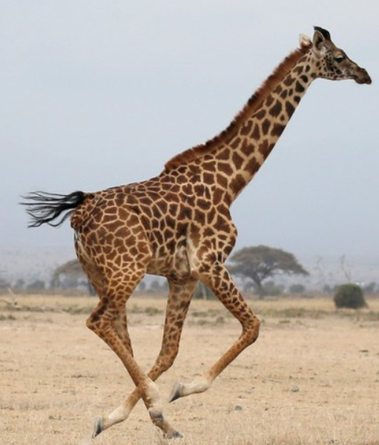
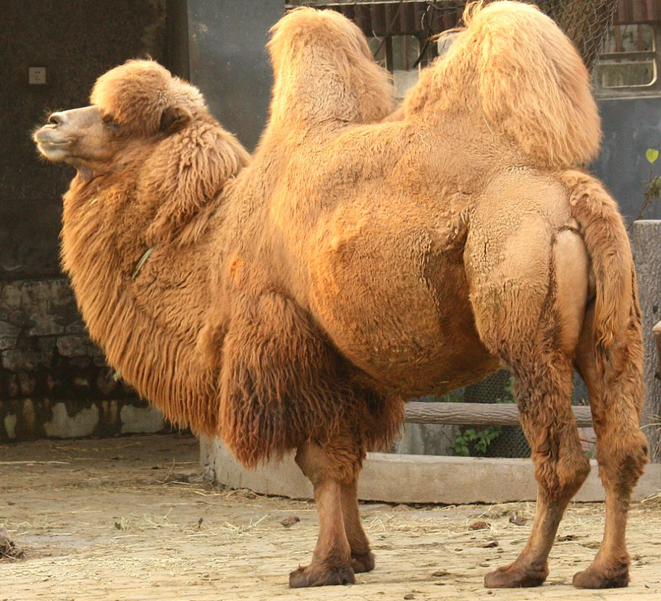
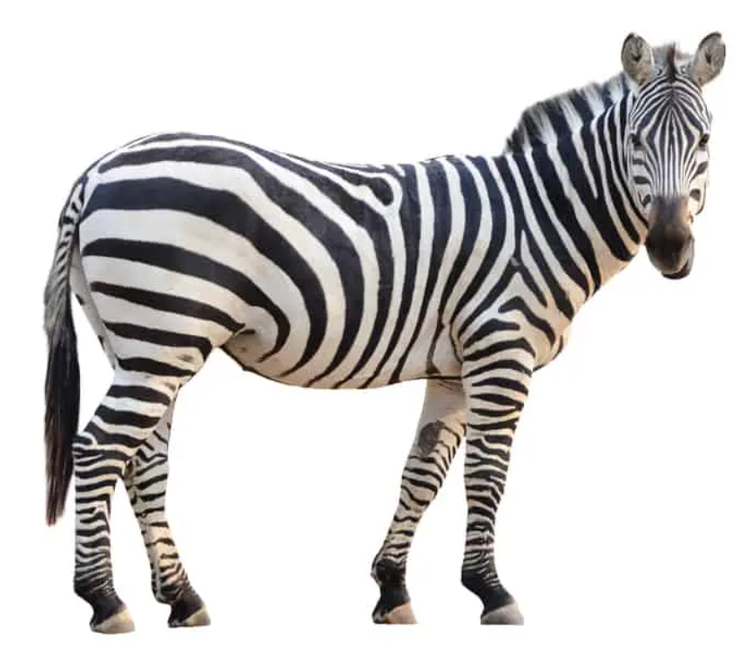
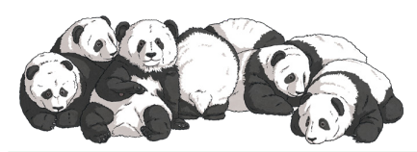
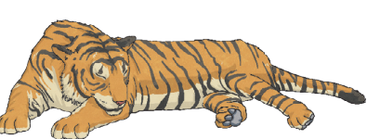
Alliteration - Write an alliterative sentence for each of the animals below and then turn your sentences into a poem about the animals you find at a zoo.
Camel
Zebra
Tiger
Panda
Giraffe

Slide 6
Alliteration - Write an alliterative sentence for the following letters.
B
H
P
R
T

Slide 7
Alliteration
Can you think of an alliterative name for a friend? Think about their personality as you try to describe them.
Write an alliterative sentence about snow.
Write an alliterative sentence about Christmas.
Write an alliterative sentence for each letter of the alphabet.
Write a short paragraph explaining why cats are better than dogs or vice versa or why coffee is better than tea or vice versa using alliteration.
Write a short story in which half the letters in each sentence begin with the same letter: Reasons why I love homework, reasons why I love rainy days

Slide 8
Alliteration - coffee example
You have to agree that coffee is better than tea! Why is it so much better? It is fresh, flavourful and frothy. You must know this is true - the evidence is clear to see. Tea is yucky. It is bitter, burnt and bad. That’s why you must agree coffee is better than tea!

Slide 9
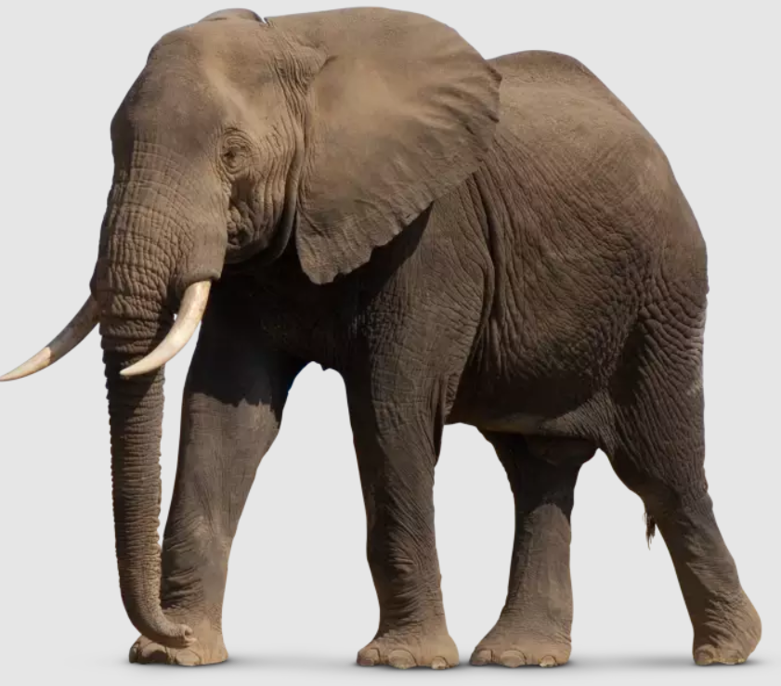
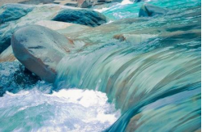

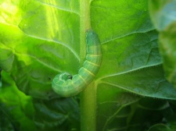
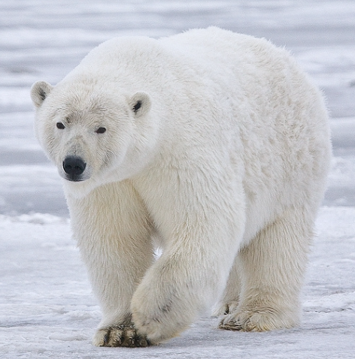

Write an alliterative sentence for each picture.

Slide 10
Alliteration - Can you spot all the alliteration?
I smiled weakly at the producer and nodded. Over her left shoulder, in the glare of the TV lights, I could make out a figure so swathed in caramel cashmere, so goldenly glowing, so astonishingly airbrushed, that she could well have been a hologram of one of the world’s most famous people.
The summer sun’s sizzling rays highlighted the numerous rows of brightly coloured towels hidden by sluggish sunbathers sprawled across the beach. Like a blue jewel, the sky stretched above the golden sand and the bustling scene of families and groups of friends enjoying the sunshine.

Slide 11
Similes - comparing two things using ‘like’ or ‘as’.
As graceful as a swan.
As blue as the ocean.
As cold as ice.
As slow as a snail.
As angry as a grizzly bear.
As hot as a desert.
As brave as a lion.
As beautiful as a rainbow.
Swims like a fish.
Runs like the wind.
Sparkled like diamonds.
Climbs like a monkey.
Sings like an angel.
Smells like a flower.
Chattered like monkeys.
Laughs like a hyena.

Slide 12
Similes - Put the following similes into sentences.
Floated like a cloud.
Hungry as a bear.
Eats like a pig.
As white as snow.
As blind as a bat.
As cute as a kitten.
Runs like a scared bunny.
Shines like diamonds.

Slide 13
Similes - Complete the sentences.
The wind howled like
The man was as tall as
The bag was as heavy as
The moon was as bright as
The grass crunched like
The cushion was soft like
The moon glowed like
Snow topped the mountain like

Slide 14
Similes - Create your own similes using ‘like’ or ‘as’.
Compare the road to something hot.
Compare a test to something easy.
Compare a day to something long.
Compare someone’s feet to something smelly.
Compare the sky to something scary.
Compare a house to something tiny.
Compare a dog to something silly.
Compare a friend to something beautiful.

Slide 15
Similes - Add similes to make these sentences more interesting.
The train was slow.
The dog was howling.
The music was loud.
The grass is green.
The girl was angry.
The garden was beautiful.
The children laughed.
The car raced along the road.
The sun shone brightly.
Snow fell on the field.

Slide 16
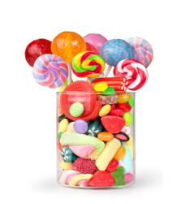
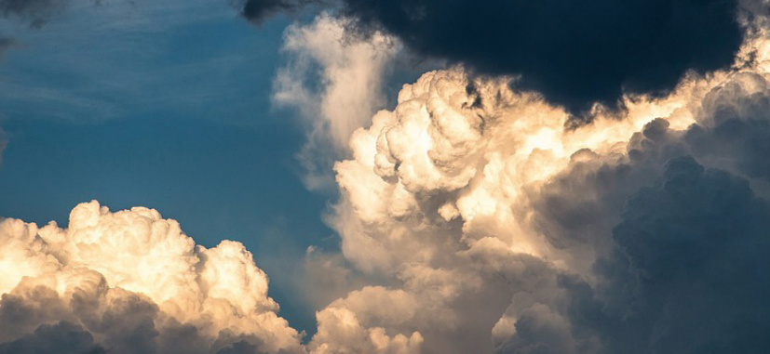
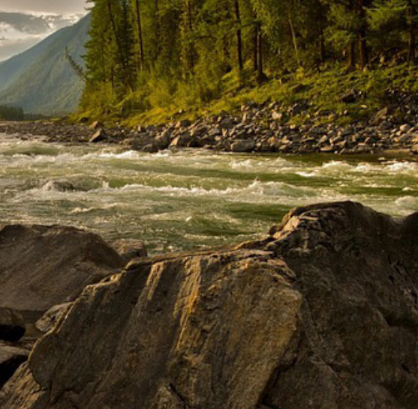
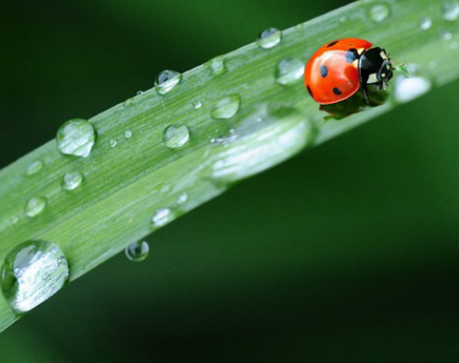
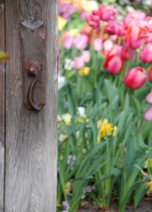
Similes - Create similes for these pictures.

Slide 17
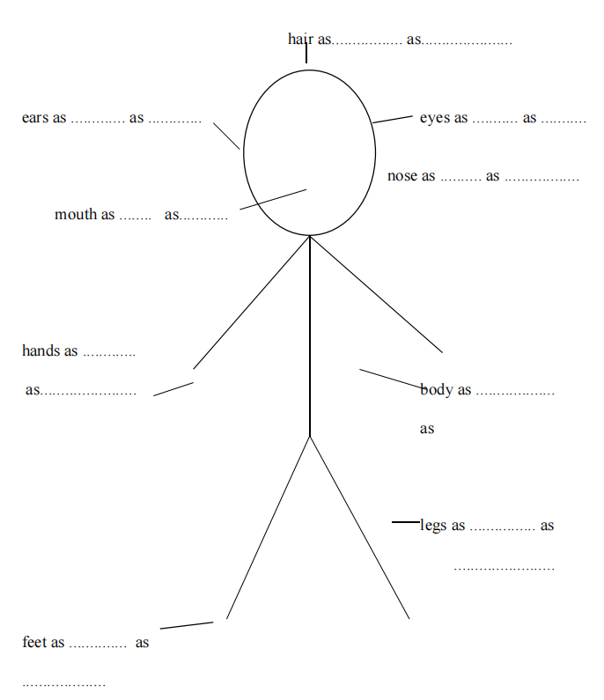
Similes - Describe a person using similes.

Slide 18
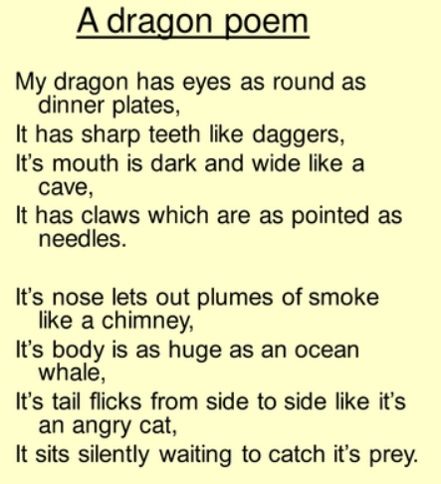
Similes - Create a descriptive poem about your pet using similes. If you don’t have a pet, choose an animal to write about. Example below.

Slide 19
Similes - Make the following sentences more interesting by using similes.
The snow is a white blanket.
She is a lazy toad.
He is a shining star.
She is an angel.
The house is a monster.
He was a brave lion.

Slide 20
Similes - Can you spot the similes?
It was the last day of school and my heart was beating like a drum - I couldn’t wait for that final bell to ring. I finally would be released from this prison and felt like a dog being set free from a cage for the first time. This summer was going to be one to remember. I would be travelling up north to my family’s cottage with my dad - we had planned to spend two full weeks there - it is my favourite place. The wildlife of birds are like nature’s orchestra and I love to listen to their songs. I love feeling the sun melt into my skin like wax from a candle when it’s heated. Summer is my playground and I can’t wait for it to begin.

Slide 21
Metaphors - Comparing two things without using ‘like’ or ‘as’. States one thing is another thing.
My dad is a teddy bear.
My mum is an angel.
Chocolate is heaven in a wrapper.
The classroom was a zoo.
Her eyes were glistening jewels.
Time is a thief.
The thunder was a mighty lion.
The sun was a gleaming pearl.
My sister is the devil.
My brother is a grizzly bear.

Slide 22
Metaphors - Write your own metaphors.
My class is
My friend is
Homework is
My bedroom is.

Slide 23
Metaphors - Write a metaphor using each pair of words.
heart rainbow
anger fire
fast computer
red cherry
delicate snowflake
sour lemon

Slide 24
Metaphors - Create your own.
Compare someone’s bedroom to something messy.
Compare a storm to something scary.
Compare Santa’s hair to something white.
Compare your mum to something gentle.
Compare a house to something big.
Compare the road to something cold.

Slide 25
Metaphors - Change the similes to metaphors.
He swam as gracefully as a dolphin.
Clouds are white like newborn lambs.
This coffee shop is like an ice box.
My hair is black like the night-time sky.
I move as fast as a cheetah in the desert.
He is like a shining star.
She is as busy as a bee.

Slide 26
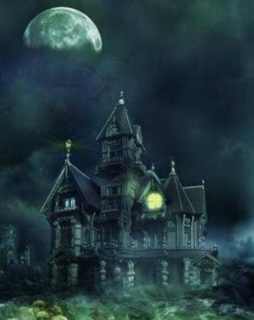
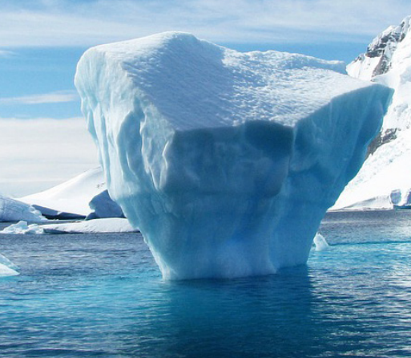
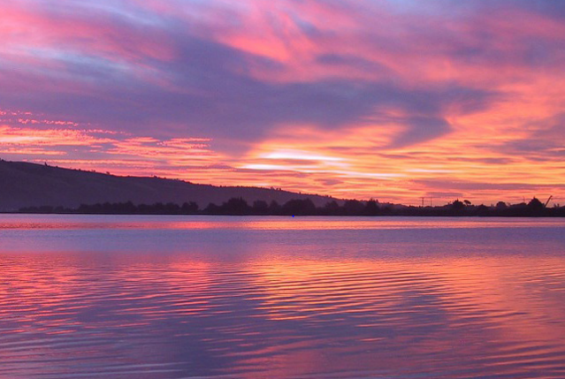
Metaphors - Write metaphors about the pictures.

Slide 27
Metaphors - Identify the metaphors.
The old tramp sits on a park bench. His eyes are misty goldfish bowls. His fingers are frail brown twigs that will snap if he releases his brown paper bag. His hair is matted straw and his skin is crumpled, dirty parchment, rough sandpaper holding his face together. His clothes are but rags and hang off him like the loose sails of a lost ship. As he sits there he shivers. He is a puppy thrown out in the cold, a broken toy, a lost child amongst strangers. An unwanted, tired, lonely old man.

Slide 28
Metaphors
Create a metaphor for happiness.
Describe yourself using only metaphors. For example: I am a tornado. My hair is a large bowl of spaghetti. My laugh is a bubbling bottle of champagne.
Create a metaphor to describe school. Make a list of all your feelings about school

Slide 29
Personification - Giving human characteristics to something non-human.
The stairs groaned as we walked on them.
The rain is dancing on the roof.
The angry sky roared and threw lightning around.
The stars winked at each other in the dark.
This computer has a mind of its own.
The fog crept in.
The car danced across the icy road.
The hungry lawnmower ate all the grass up.
The ocean tickled my feet.

Slide 30
Personification - Write a sentence using personification for each of the words below.
The moon
A cat
Summer
A rainbow
A dog
A tree

Slide 31
Personification - Use the pair of words below to create a sentence that uses personification.
flowers danced
music floated
tyres screamed
elephant imagined
birds chattered
engine coughed
moon watched

Slide 32
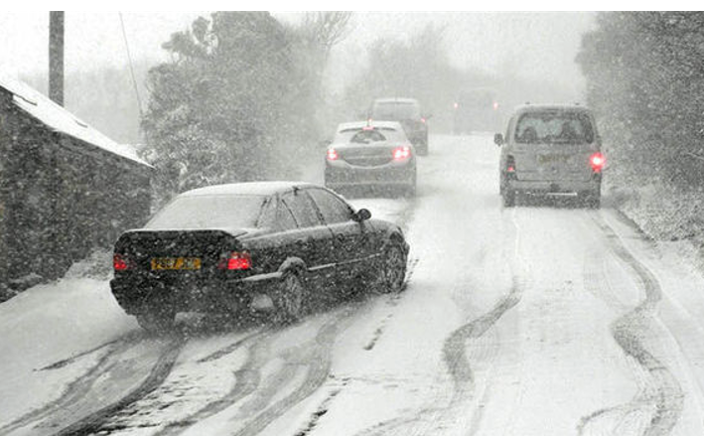

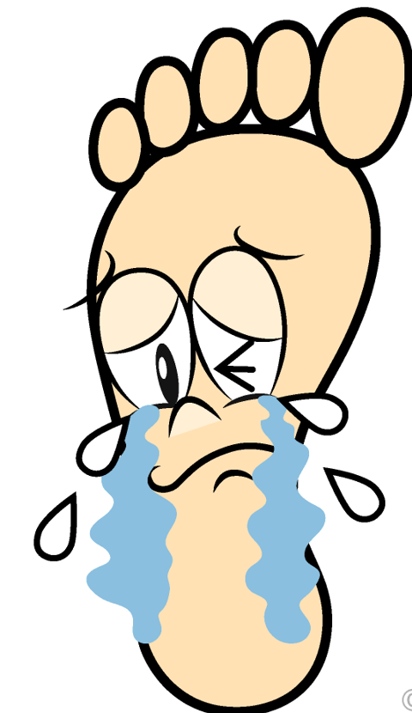
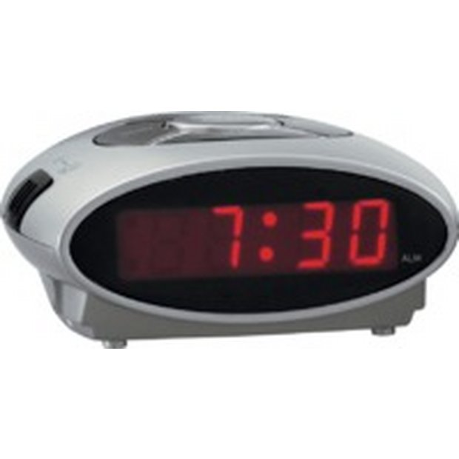
Personification - Create personification for the pictures.

Slide 33
Personification - Personify your pen.
Look at the pen you are using. Examine it carefully.
Where was your pen made?
How old is your pen?
Is your pen happy or sad?
If your pen had a voice, what would it sound like?
What does your pen like writing the least?
What does your pen like writing the most?
Does your pen have any friends? Who are they?

Slide 34
‘Spring doesn’t like this garden so we can live here all year,’ they say. The Snow covers the grass with her great white cloak, and the Frost paints all the trees silver. They invite the North Wind to stay with them. All day he roars about the garden and blows the chimneys down. ‘This is a lovely place,’ he says, ‘we must ask the Hail to visit.’ So the Hail comes. Every day for three hours he rattles on the roof of the castle until he breaks most of the slates. Then he runs round and round the garden as fast as he can go. He’s dressed in grey and his breath is like ice.

Slide 35
Personification - Identify the personification.
Wearily, I dropped my suitcase on the floor and gazed up at the new building which I was now to call home. The tall, grim walls glared at me and the oak door protested as I hesitantly pushed it open. I took a step forward and the floor groaned as though it resented my presence. The house didn’t want me.

Slide 36
Onomatopoeia - A type of word that imitates the sound it represents.
pop
bang
buzz
splash
hiss
crunch
sizzle
slurp
whoosh
quack

Slide 37
Onomatopoeia - Write an onomatopoeia for each of the following.
A fire engine
Someone sneezing
Sausages cooking in a pan
A kettle boiling
A doorbell
A clock
A thirsty cat drinking milk
A wolf
A dog
A storm

Slide 38
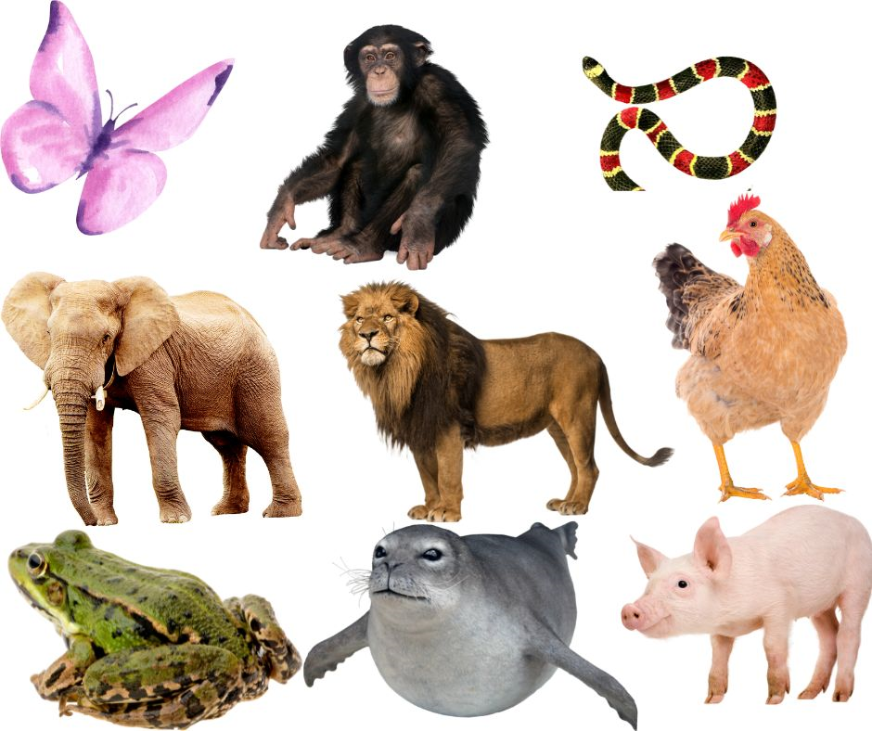
Onomatopoeia - What sounds do each of these make?

Slide 39
Onomatopoeia - Can you identify the onomatopoeia in each sentence?
The dead leaves on the ground rustled in the cool, crisp wind.
The snake slithered across the grass and did not make a splash when it slid into the water.
I felt like everyone stopped and looked at me when my lunch tray clattered to the floor.
She muttered under her breath and snapped her notebook shut.
The ring of my alarm clock does not wake me up but my mother screeching that breakfast is ready does the trick.

Slide 40
Onomatopoeia - Writing with onomatopoeia.
Write a paragraph telling about a time you experienced a thunderstorm. Include at least two examples of onomatopoeia.
Write about a spooky house using onomatopoeia.
Write about a happy pig using onomatopoeia.
Write about a person with a cold using onomatopoeia.
Write a poem using onomatopoeia. I like sounds. The whistle of the wind. The _____ of the _____. The _____ of the _____. The _____ of the _____. The _____ of the _____. I like sounds.
Try this for sport and school.

Slide 41
Onomatopoeia - Rewrite the following using onomatopoeia.
The boat moved through the water. The air was heavy. Birds called and unseen creatures moved into the water. Stinging bugs flew around the boat. Suddenly, Jack heard something travelling in the dense bushes. He stifled a call when the thing came through the leaves onto the river bank. It was just his dog, Buddy!

Slide 42
Onomatopoeia - Identify the onomatopoeia.
When Sarah got home, she went straight to the kitchen to make herself a hot chocolate. The kettle began whistling, the mug clinking as she set it down on the counter. She squirted the cream as high as a mountain and added lots of little marshmallows on top. Then she sank slowly squeaking into her soft leather sofa and slurped her drink happily.

Slide 43
Hyperbole - An expression that over exaggerates something.
I’m so hungry I could eat a horse.
The whole world was staring at me.
I’m so tired I could sleep for a year.
I must have walked a hundred miles.
I have told you a thousand times.
This is going to take forever.
I haven’t seen you for ages.
I’m trying to do a million things at once.

Slide 44
Hyperbole - Create your own hyperbole.
The TV is so loud
The snow is so deep that
I have so much homework
That dog is so old
It is so cold in here
My computer is faster than
The wind almost blew the
The car was so slow

Slide 45
Hyperbole - Write a hyperbolic sentence using each idea below.
extremely loud
very thirsty
very expensive
very heavy
very cute
a boring movie
a cold house

Slide 46
Hyperbole - Identify and explain the hyperbole in each sentence.
It was so hot that my skin began to melt.
He had to defy a billion odds on his way to success.
Every minute of waiting felt like an hour.
That food was so hot my ears were smoking.
She cried so long that she made a lake.
I nearly died laughing.
You have a million toys at your house.

Slide 47
Hyperbole - Express these ideas in the form of hyperbole.
This sport is fun.
The movie is interesting.
We bought a lot of sweets.
My legs are long.
My dad is funny.
My room is big.
That dog is cute.

Slide 48
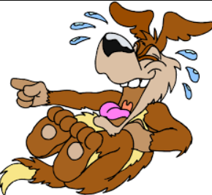
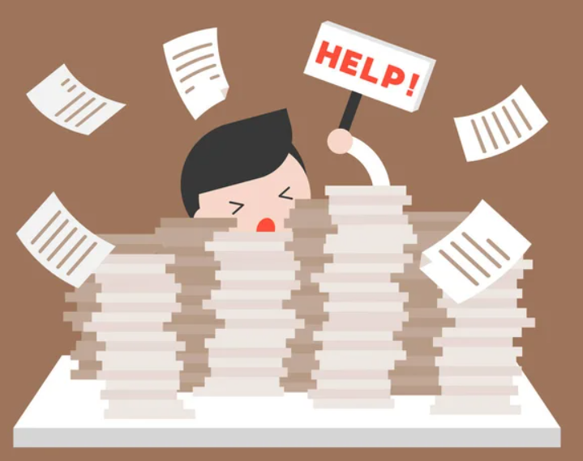
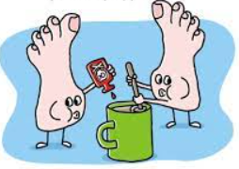
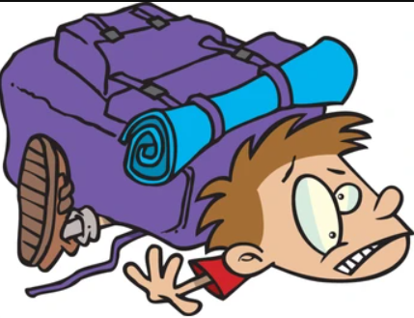
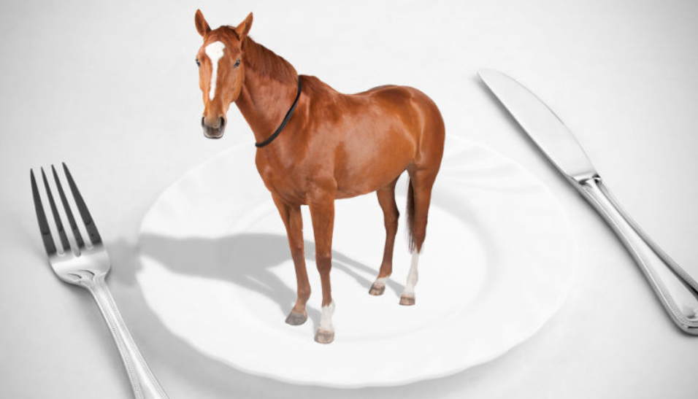
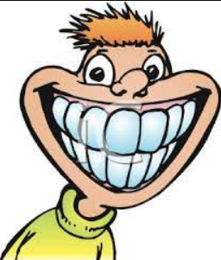
Identify the hyperbole from the pictures.

Slide 49
Hyperbole - Identify hyperbole in the following.
On sports day, teachers carried millions of boxes to the school field containing equipment needed for the day. Dan ran faster than a car to win the year 6 race.
The explorers continued to trek north towards the arctic circle. It was so cold even the polar bears were wearing thermal gloves and hats. The group trudged through snow deeper than the ocean to reach their final destination.

Slide 50
Oxymorons - A word or phrase that contradicts itself.
Act naturally
Clearly confused
Seriously funny
Deafening silence
Loud whisper
Working holiday
Organised mess
Still moving

Slide 51
Oxymorons - Write a sentence with the following oxymorons.
student teacher
small crowd
least favourite
awfully good
run slowly
honest thief
deliberate mistake

Slide 52
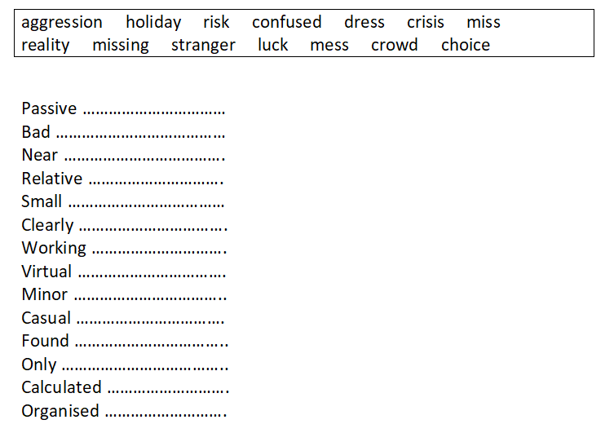
Oxymorons - Match up a word from the box to create an oxymoron.

Slide 53
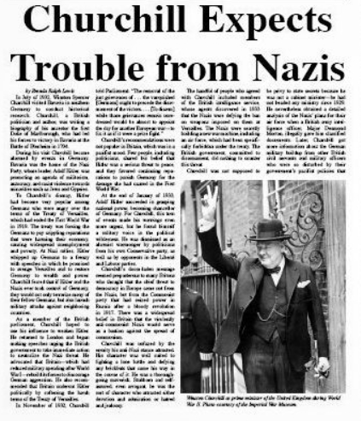
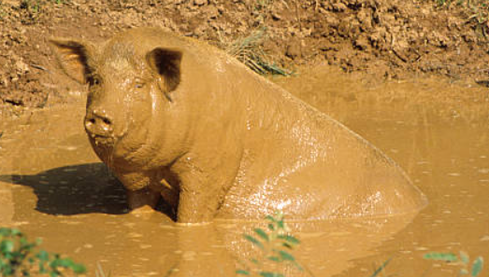
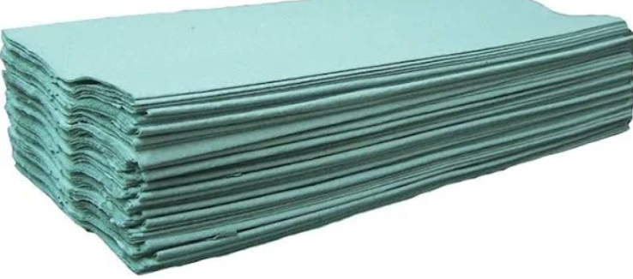
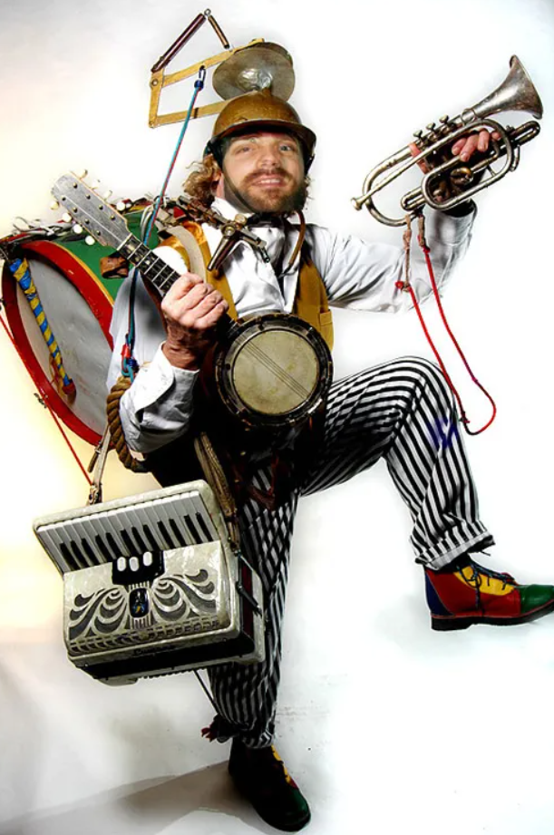
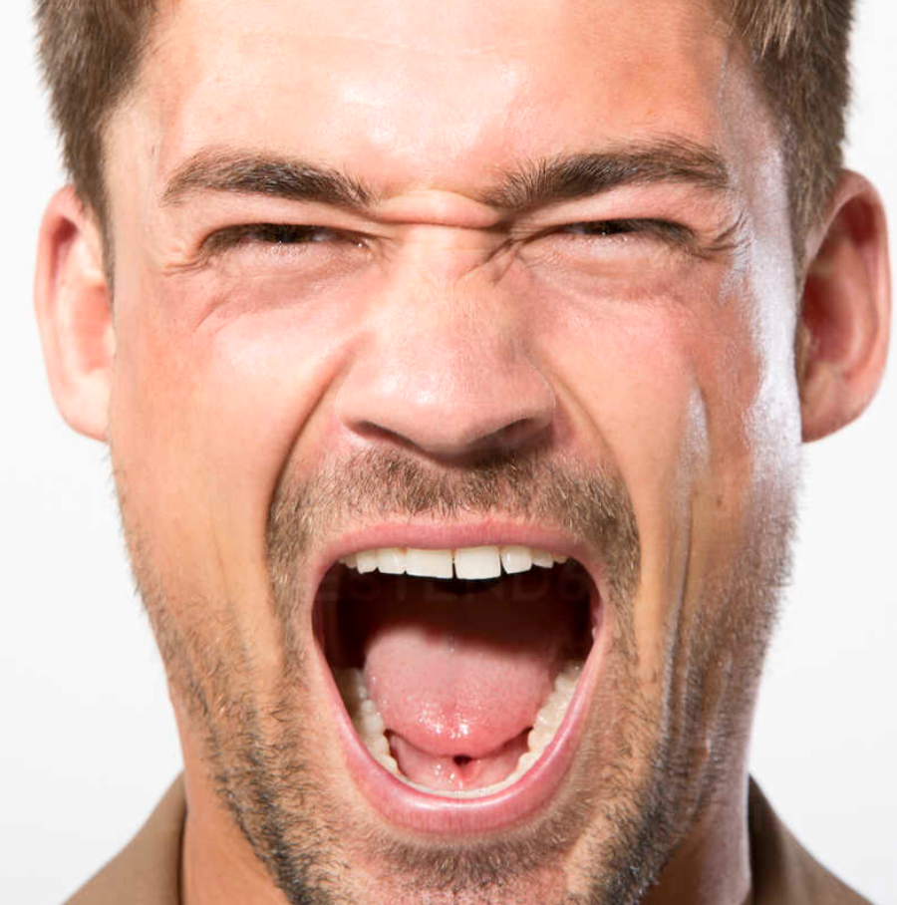
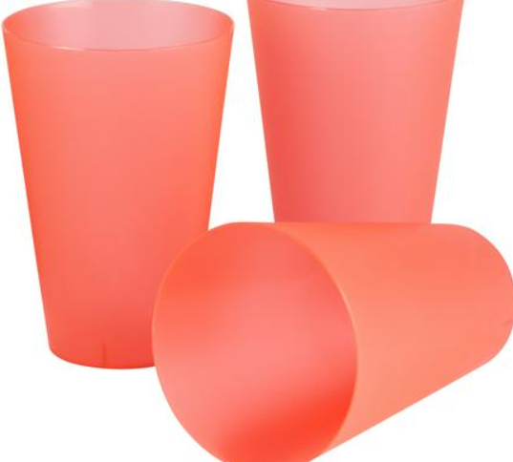
Oxymorons - Identify from pictures

Slide 54
Oxymorons
Can you write a paragraph containing at least four oxymorons.

Slide 55
Oxymorons - Identify the oxymorons
I tried to turn a blind eye to the state of the room. It was the aftermath of the farewell reception for Joe, who had been promoted as a sergeant in ‘G’ Brigade. What an honour for such an advanced beginner!
The floor was covered in plastic glasses and all items of party food and in the dim light I wondered if Joe was the right person for the job or was he just a clever fool?

Slide 56
Idioms - Phrases that don’t make sense
Bring home the bacon
Take a rain check
Cold feet
Caught red handed
Eyes in the back of my head
Black sheep of the family
Can’t swing a cat in here
When pigs fly
Cost an arm and a leg
Raining cats and dogs

Slide 57
Idioms - Explain the meaning
Don’t let the cat out of the bag.
Walls have ears.
Sitting on the fence.
Break the ice.
Spill the beans.
On cloud nine.
Out of the blue.
See eye to eye.
Green thumb.
Wave the white flag.

Slide 58
Idioms - Use each idiom in a sentence and then explain what it means.
under the weather
down to earth
butterflies in my stomach
tie the knot
piece of cake
over the moon
in the dog house
walls have ears

Slide 59
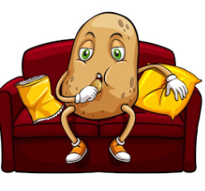
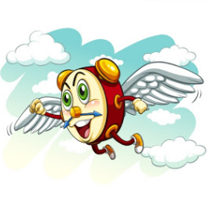
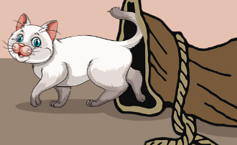

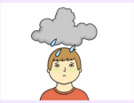

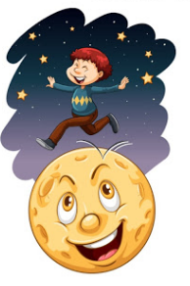
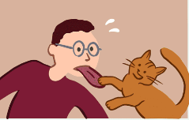
Identify the idioms

Slide 60
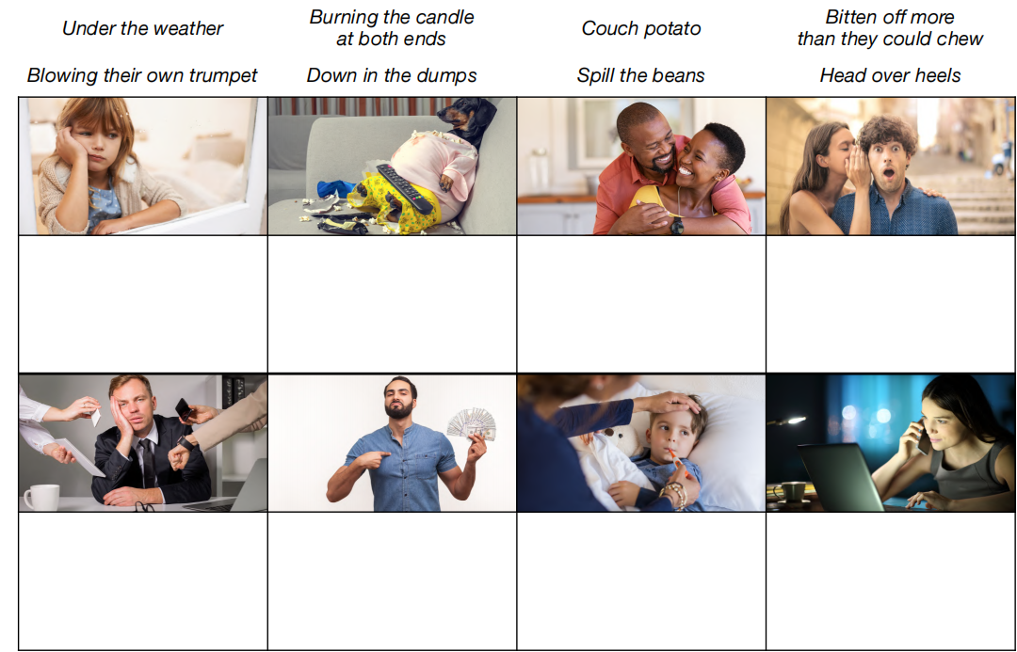
Idioms - Write a sentence about each picture using an idiom.

Slide 61
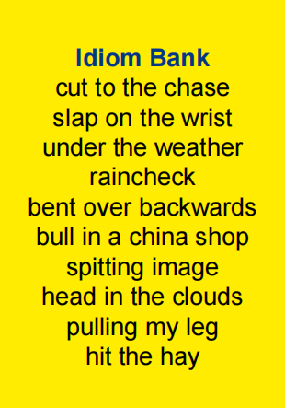
Idioms - Rewrite the sentences using idioms from the box.
Mrs. Smith tried very hard to help me.
Fred is walking in a daze.
Emma is not feeling well.
Marie looks exactly like her older sister.
I’m tired so I’m going to sleep.
Are you kidding me?
Will you get to the point?
Lee can’t go to the cinema today, he wants us to ask him another time.

Slide 62
Idioms - Identify the idioms.
I felt over the moon because after feeling under the weather for so long I now felt on top of the world again. It all began on a day when it was raining cats and dogs. I felt like I was losing my marbles because someone had bitten my head off for no reason. It was later in the day when I tried to get to the bottom of it and I began to see the light. My friend hit the nail on the head when she said that the other person had got their knickers in a twist. She then said, “Keep your hair on.” And went on to suggest that she turned over a new leaf so that more people liked her.

Slide 63
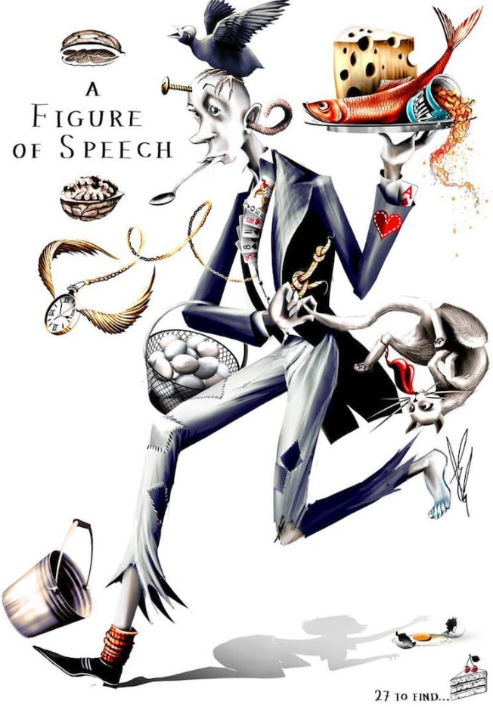
Identify as many figures of speech as you can.

Slide 64
Identify the figures of speech
1. The trees of the forest watched sympathetically over the lost child.
2. They fought like cats and dogs.
3. Smoke belched from the factory chimneys beside the river.
4. This bedroom is like a prison.
5. I will die if he asks me to dance.
6. The cloudy sky seemed so sad.
7. I can’t make any promises but it’s a definite possibility.
8. That was the straw that broke the camel’s back.
9. My new car cost me an arm and a leg.
10. The teacher thanked me for all my help.
11. My best friend is the class clown.
12. Our feet squished in the mud.

Slide 65
Identify the figures of speech.
1. I could listen to my favourite song forever.
2. Wendy was washing the windows when I arrived.
3. I had to go through the pain for pleasure.
4. Time creeps up on you.
5. It’s hard to keep a stiff upper lip when everything is falling apart.
6. Your new shoes are a little big.
7. It’s so cold in here that there are icicles on my nose.
8. The sun is a creature of habit.
9. My car is screaming to be washed.
10. The wind whooshed through the trees.
12. My eyes are as blue as the ocean.

Slide 66
Identify the figures of speech
The summer sun’s sizzling rays highlighted the numerous rows of brightly coloured towels hidden by sluggish sunbathers sprawled across the beach. Like a blue jewel, the sky stretched above the golden sand and the bustling scene of families and groups of friends enjoying the sunshine. Gently, waves lapped onto the sand, white froth capping the ripples like the bubbles on top of a fizzy drink. The calm suck and whoosh of the waves mingled with chatter, shouts and general summer day happiness from the sun worshippers.

Slide 67
Identify the figures of speech
The evening sky was a jet black blanket with diamonds sewn onto it. Ronald Reeve was over the moon that his rocket was ready to be blasted into the sky. As time crept closer to 9pm, Ronald tiptoed like a ballerina from his bedroom and gently gripped the rocket in his hands. Indeed, his rocket was his baby. Ronald was a night ninja stealthily moving towards the middle of the gigantic garden. This must have been his NASA launch pad! Ronald`s fuel was a crazy concoction of gasoline, baking powder, charcoal and nitrogen gas. He stood back and lit the fuse. ‘Fizz!’ and ‘Crackle!’ bellowed from his rocket and then a loud ‘Whizz!’ ran into his ears as the rocket sped off into the air at a million miles an hour spiralling out of control. It was heading for the moon until the rocket exploded into a rainbow fountain and a deafening ‘Bang!’ woke all of the neighbours. Ronald didn’t seem too disappointed as a sneaky smile slithered across his face and a sniggering laugh darted from his mouth. Ronald was a little devil, happy with his nights work!

